Slide 1
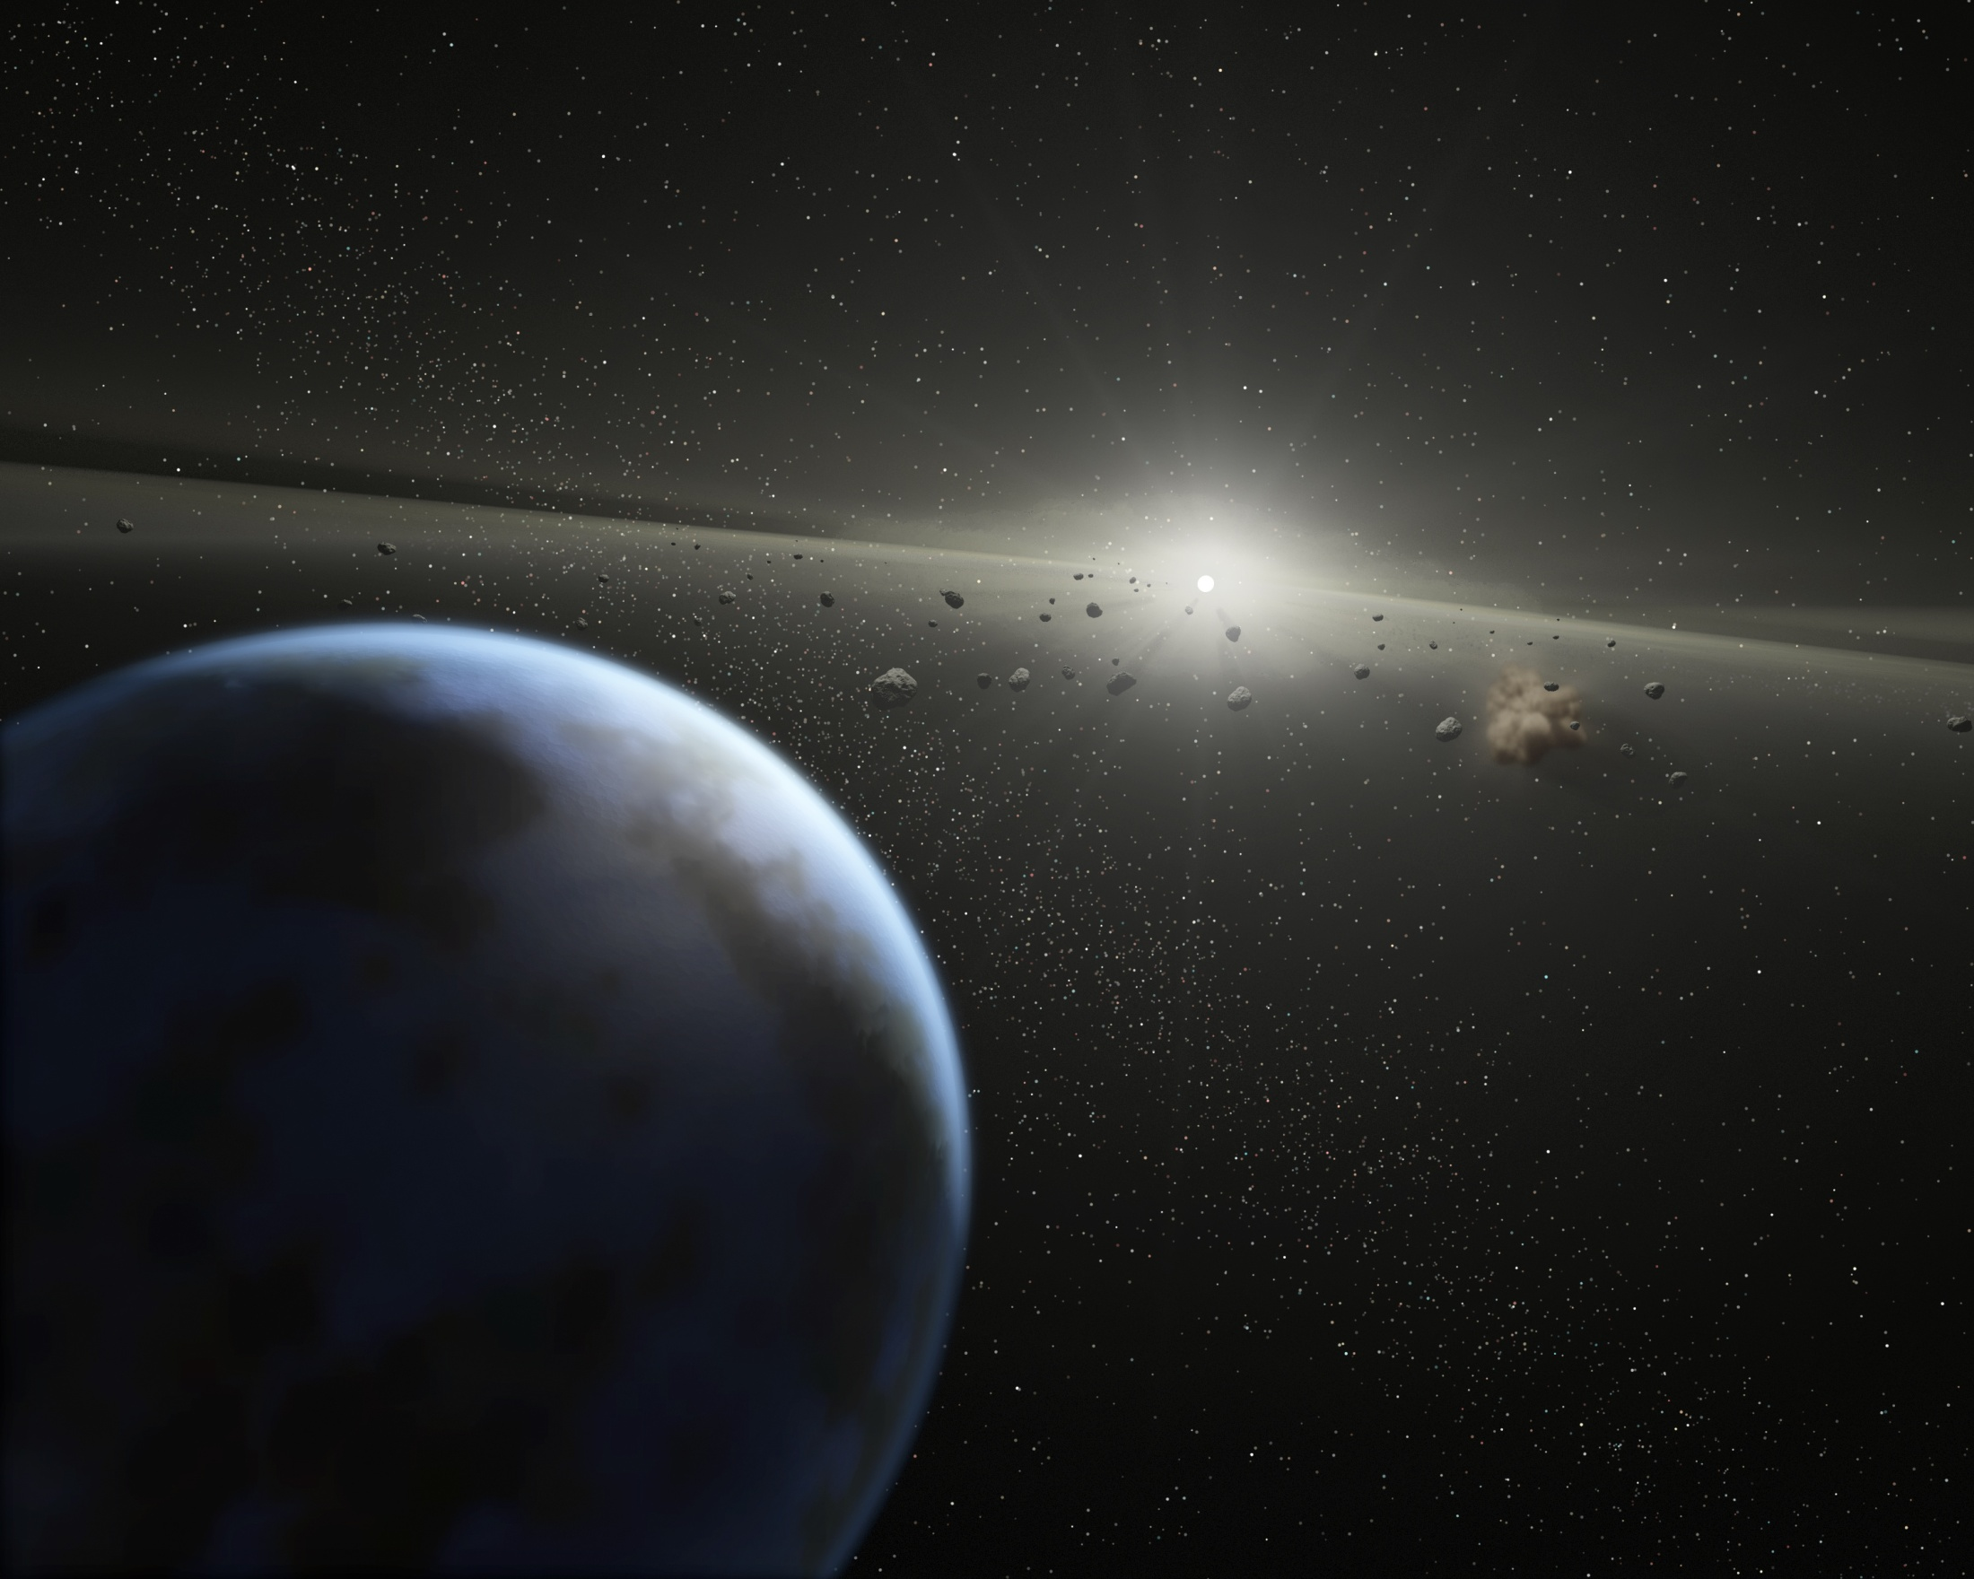
ExoZodiacal Emission and Challenge and Opportunity for The Detection of ExoPlanets
C. Beichman
Friday, March 26, 2010
5 AU Workshop
With lots of help from A. Tanner (Georgia State), G. Bryden (JPL), S. Lawler (Wesleyan/UBC), R. Akeson (NExScI), D. Ciardi (NExScI), C. Lisse (JHU), Mark Wyatt (Cambridge)

Slide 2
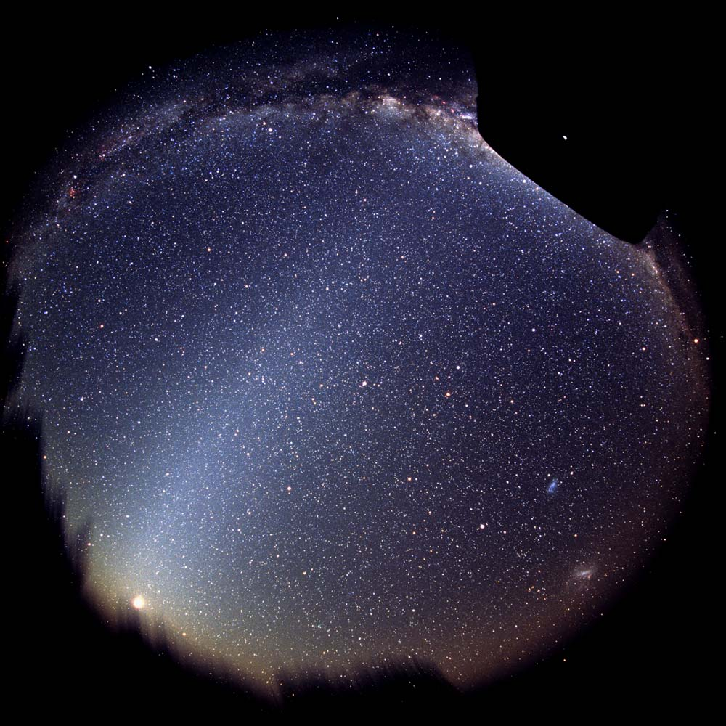
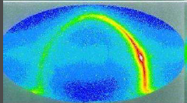
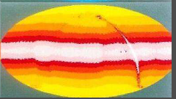
Debris Disks and Formation of Planets
Prediction of debris disks by Witteborn et al (Icarus 1982)
  “Accretion models of planet formation and the early cratering history of the solar system suggest that planet formation is accompanied by a cloud of debris resulting from accumulation and fragmentation. A rough estimate of the infrared luminosities of debris clouds is presented for comparison with measured 10-micron luminosities of young stars. New measurements of 13 F, G, and K main-sequence stars of the Ursa Major Stream, which is thought to be about 270-million years old, place constraints on the amount of debris which could be present near these stars.”
IRAS discoveries followed in 1984 (Aumann, Gillett et al)
Fractional luminosity, Ld/L*, a convenient metric
  1-10⁻² for protostars & classical T Tauri stars
  10⁻³ to 10⁻⁴ for brightest, youngest (?) disks --- accessible to non-IR
  10⁻⁴-10⁻⁵ for typical disks --- IRAS& ISO for early Sp Type→Spitzer
  10⁻⁶-10⁻⁷ for weak disks like solar system
COBE 3 μm
COBE 25 μm

Slide 3
Points To Consider
Evolution
Census
Where is the material?
What is the material?
What is the effect of planets
What is the effect of EZ on planet detection
What could we learn about EZ from our own LZ

Slide 4
Disk Fraction Declines with Age: Primordial→Debris
Spitzer surveys of AFGK stars (Rieke 2004; Siegler 2007) confirm and extend ISO results
Young, hot disks common, but rare beyond 100 Myr → formation of planetesimals and planets common evolutionary feature <100Myr
Sporadic later outbursts due to collisions (Vega, HR 8799 Su 2004) with multiple grains sizes
Siegler et al. 2007

Slide 5
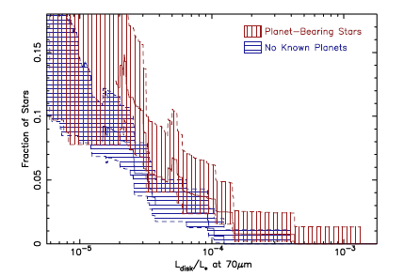
Spitzer Results On Kuiper Belts
L_{d}/L*~10⁻⁵ ~10⁻⁶ for cold Kuiper Belt dust (30-60 K, >10 AU; 70 μm) for roughly 14% of MATURE stars.
No statistical difference between debris disk incidence for stars with or w/o planets
Most systems consistent with large dust grains, relatively warm dust located just outside snowline
Bryden et al 2009

Slide 6
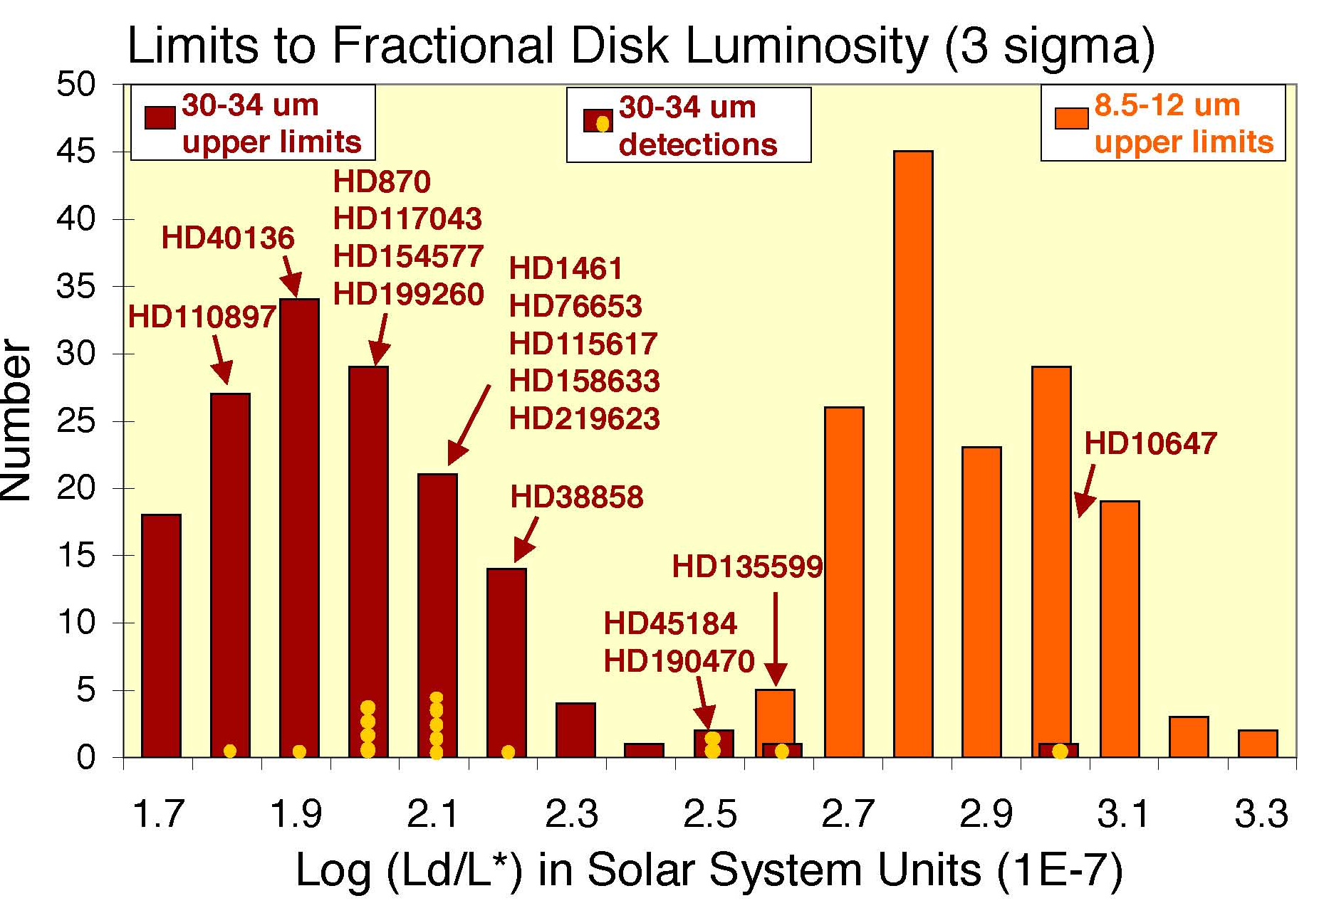
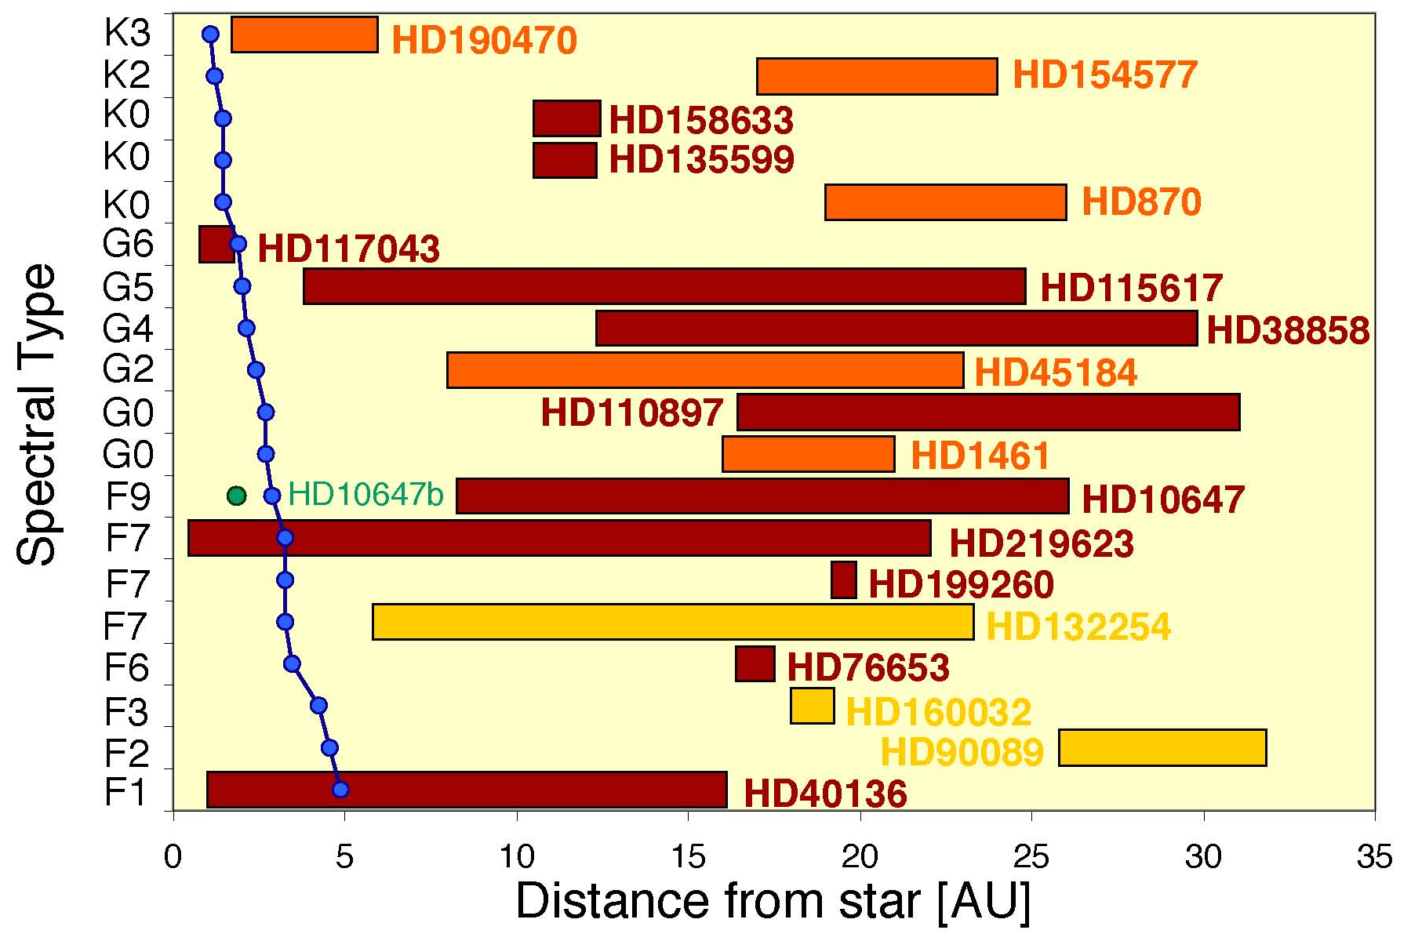
Spitzer Limits on Hot Dust
Most Kuiper Belt systems show WARM dust (70-150 K) located outside ice-line ~100 Zodi
HOT dust in Habitable Zone (10 μm) rare
  ~1,000 zodi (3 σ) for 1-2% of mature stars
Only 1-2 systems with strong HZ disk at Spitzer photometric levels
Lawler et al 2009
Lawler et al

Slide 7
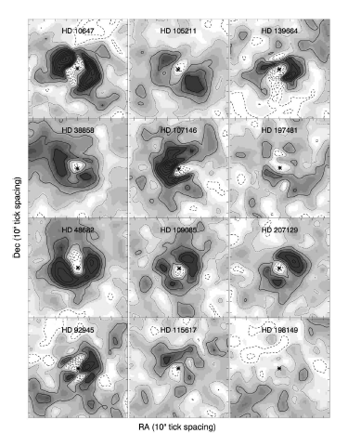
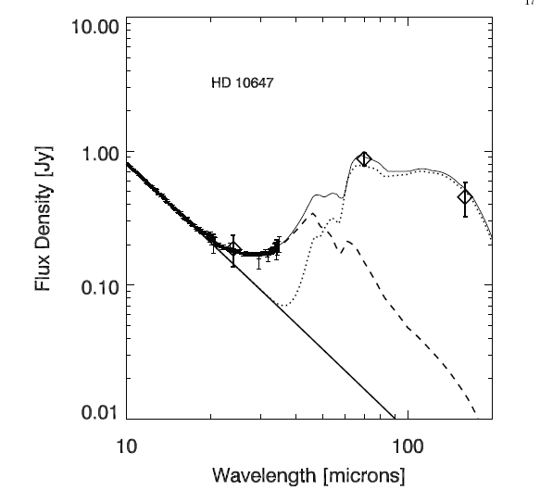
Large Warm Disks
11 of 41 70 μm excess sources are extended (>10″) → 30-100 AU (Bryden)
HST confirms size and PA of many
Herschel/SCUBA-2 will resolve dozens of objects
Submm shows
large, cold disks
Large distance from star → small dust grains for T~30K, e.g. HD 10647 with outer ring of 0.25 um silicates or water ice (Tanner et al)
Origin as fossil collisional event

Slide 8
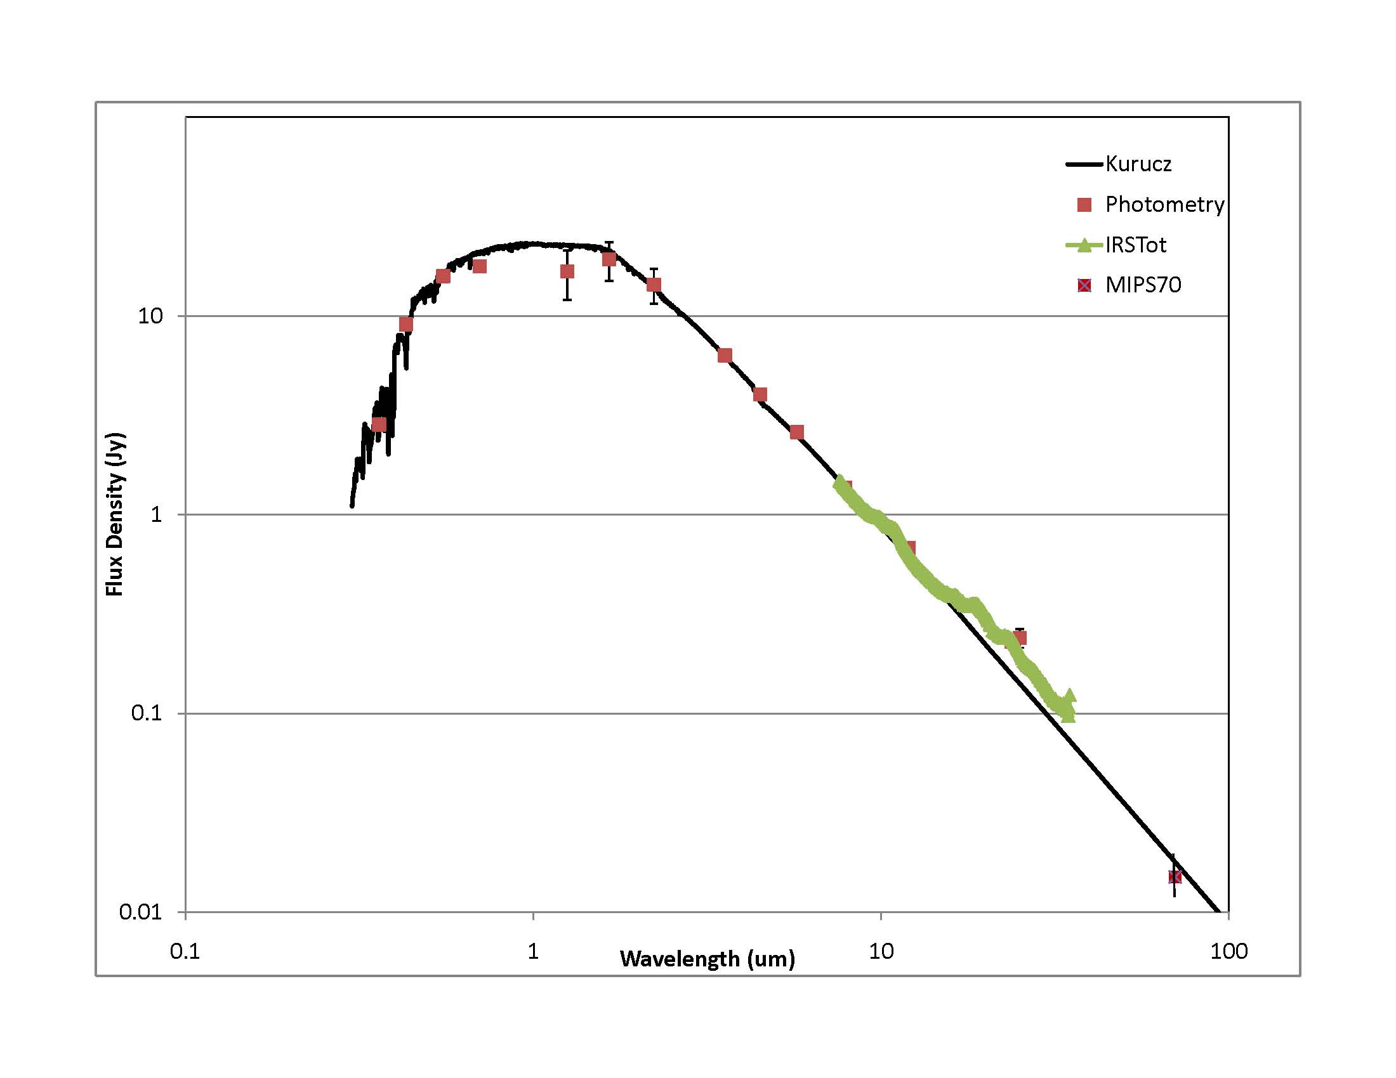
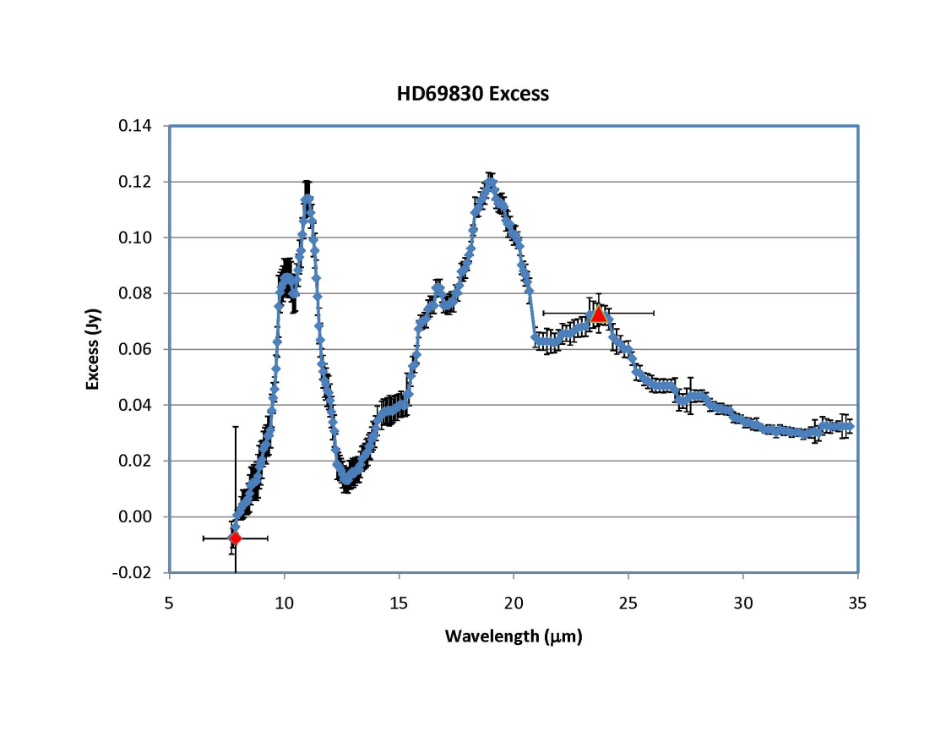
The Exceptional Star HD 69830
Laboratory For Planet Disk Interactions
HD 69830
Asteroid Belt
6th mag K0 V star
12 pc distant, Age 2-5 Gyr
3 Neptune Sized Planets
@ 0.08, 0.16, 0.63 AU
ecc<0.1
NO Kuiper Belt

Slide 9
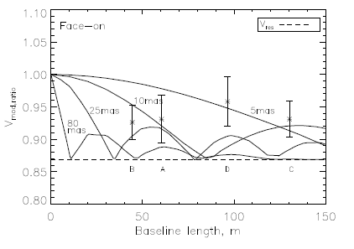
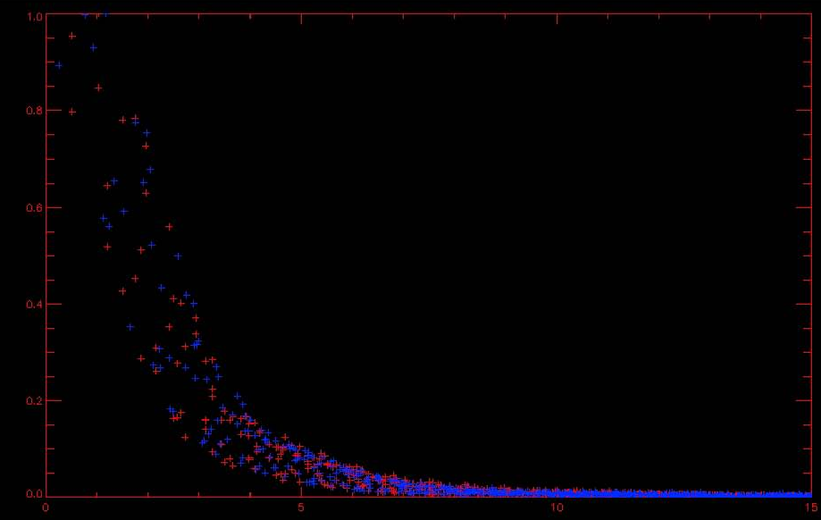
Disk Location and Extent
SED→ material at 1 AU, 2:1 or 5:2 resonance outside most distant planet
  VLTI/MIDI resolves emission, 0.25 -1 AU (Smith, Wyatt and Haniff 2009)
  No Keck-Interferometer excess at 3 μm (Akeson)
Debris from R~30 km C-type asteroid disrupted after perturbation by planet
1.2 AU
Lovis et al 2006
Unresolved with Gemini @ 11 μm (0.3” →4 AU)

Slide 10
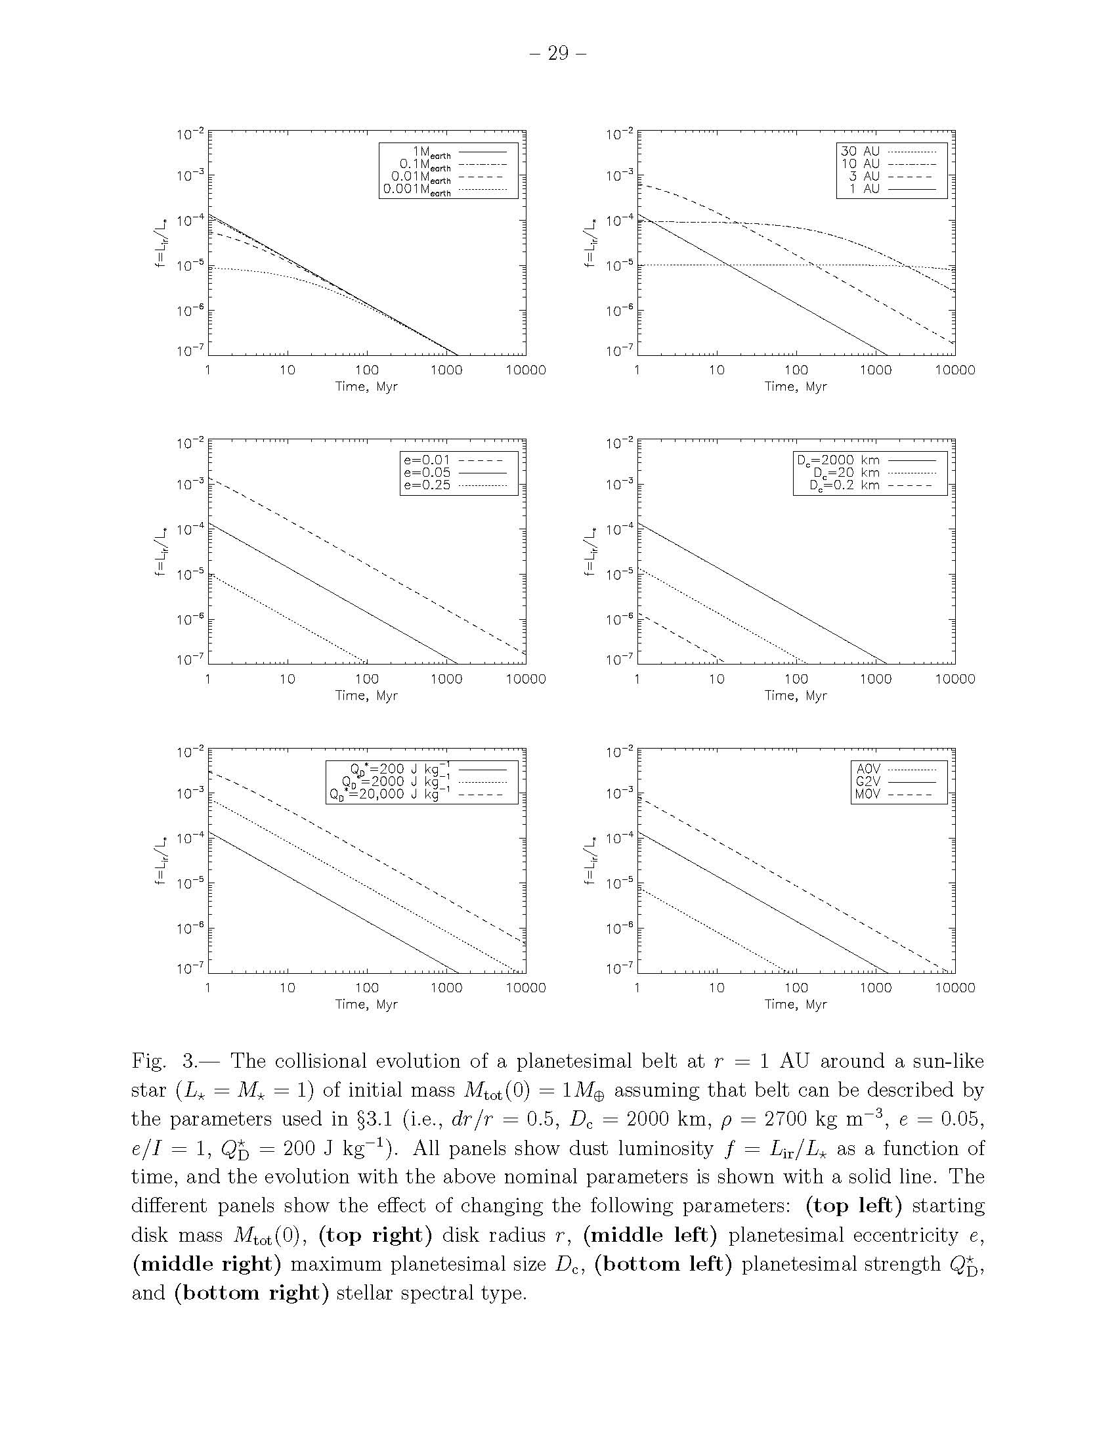
Evolution of Hot Dust Disks
Long term decline due to dissipation at few AU implies mature systems may be clean (few Zodi)
Hot dust disk in mature stars may be LHB analogs
Ages of our sample stars
HD69830
What we can measure with IRS
?????
TPF Limit
Our solar system
Wyatt et al. 2006

Slide 11
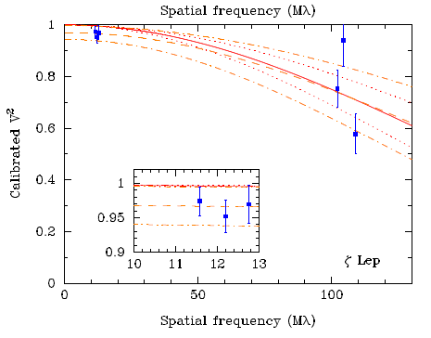
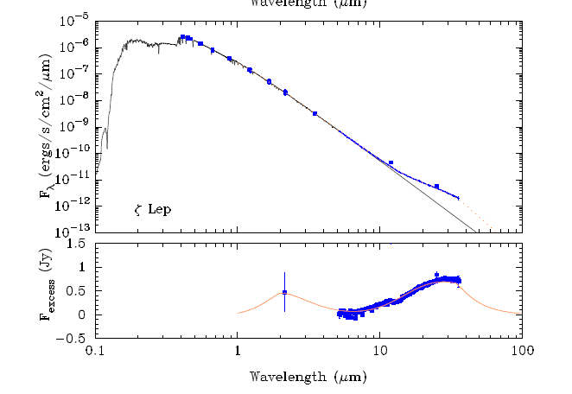
Very Hot Dust
Interferometers (PTI, CHARA) have identified hot dust at sublimation radius of A stars known EZ clouds
Inner ring: R=0.16 AU dR=0.05 AU,
Outer ring: R = 0.8 AU, dR = 13 AU
Ciardi et al, Akeson et al.
2 to 10 μm flux ratio requires small, hot, non-silicate grains
  Grain size below nominal radiation blowout radius
  Transient event
Minimum mass from breakup of single 10 km radius body
Collisions in planetesimal belt at < 1 AU

Slide 12
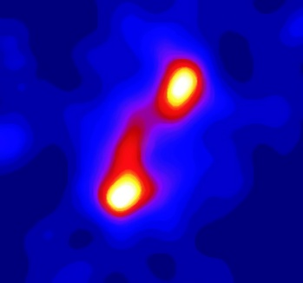
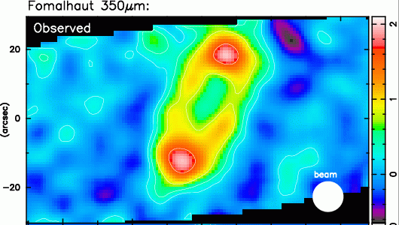
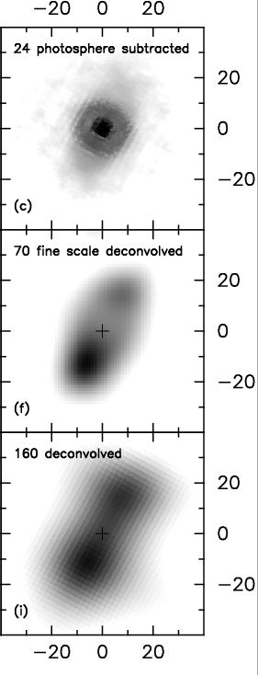
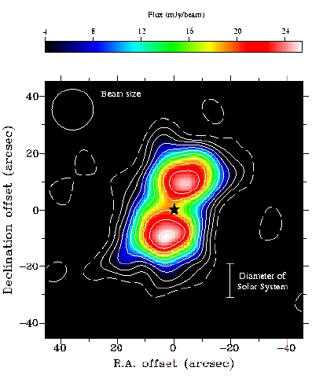
Fomalhaut’s Resolved Disk Hints at Planets
(Stapelfeldt 2004)
CSO 350 μm
(Marsh 2005)
JCMT 450 μm
(Holland 1998, 2003
Wyatt 1999)
JCMT 850 μm
A3V star at 7.7 pc; 200 Myr
Submillimeter suggest disk perturbed by planet (e=0.07)
MIPS resolves SE ansa into a ring with azimuthal variations from warmer dust at periastron
CSO 350 μm ring displaced from star by 8 AU
  Excess of material at apocenter due to slow orbital motion
  Perturber: 86 AU orbit and e=0.07
  M>> MEarth
JCMT/ SCUBA
450 μm
(Holland 2003)

Slide 13
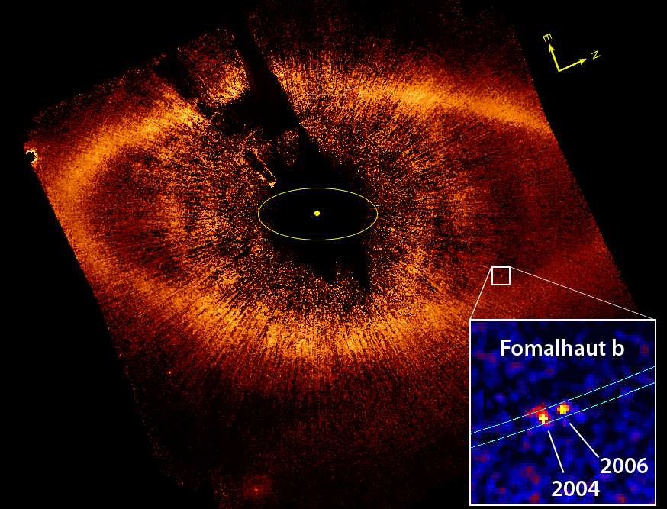
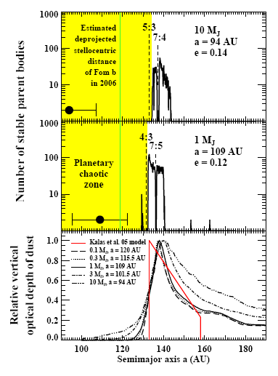
HST/Keck Finds Cause of Fomalhaut Disk Offset
Kalas et al (2009) directly detect Fomalhaut-b at 115 AU, e~0.13
Common Proper Motion and orbital motion (1.4 AU in 1.7 yr)➔P=872 yr
Quasi-dynamical mass: M< 3 MJup to avoid disrupting/spreading disk

Slide 14
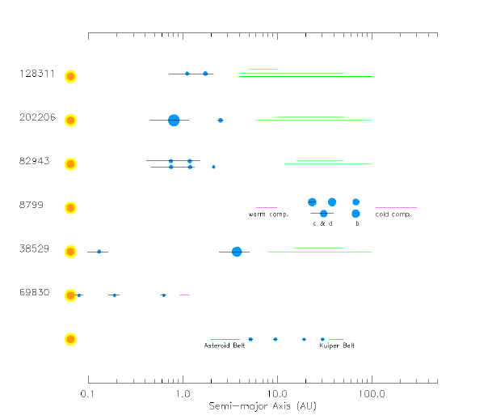
Disks and Multiple Planets
Moro Martin et al, in preparation

Slide 15
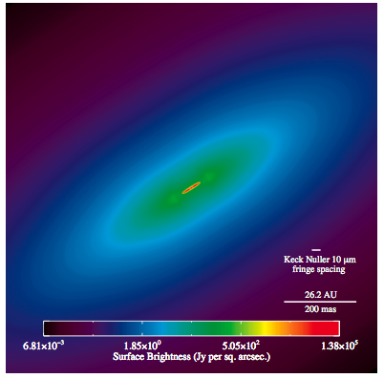
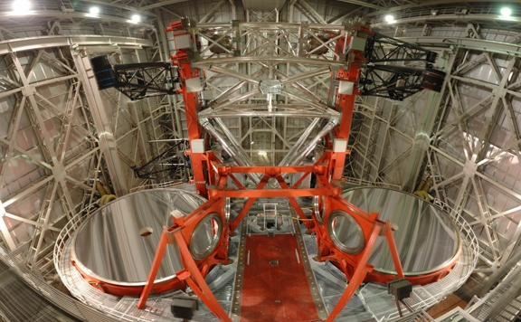
Next Steps in EZ Research
Spitzer (even JWST) limited by photometric accuracy
Interferometers null star signal to reveal disk: 10 mas resolution with Keck → 0.1-1 AU
Keck ExoZodi survey of nearby stars
  Hinz, Kuchner, Serabyn
51 Ophiuchus
Stark et al. 2009
Fit Spitzer, Keck-I, MIDI with 2 dust clouds:
1) inner ring of large grains (“birth ring”)
2) small particles (maybe β meteoroids)
LBTI will reach ~10 zodi (5-10x KI)

Slide 16
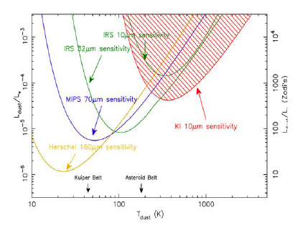
Ground-based Zodi Survey Prospects
Space-based (Spitzer, JWST) cannot get below 1000 Zodi at 10 μm
Ground based observations at few hundred Zodi, 3-4x Spitzer
LBTI will go below 100 SS, perhaps as low as 10 SS, approaching TPF limit
Modest extrapolation with theory may satisfy concerns
LBTI Limits

Slide 17
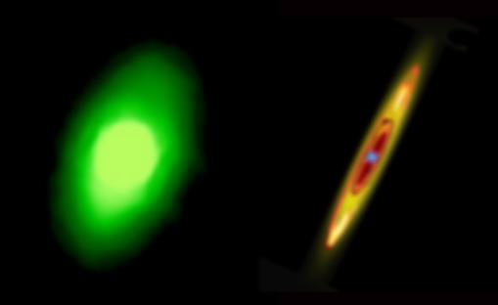
Future Capabilities
Herschel/SCUBA-2 will map dozens of resolved systems, probing cold dust (160 um) 3-10x more sensitive/resolution than Spitzer
JWST/MIRI and NIRCAM will give resolved, spectroscopic maps of brightest, biggest disks allowing detailed study of structure, including composition gradients
Fomalhaut
JWST/NIRCAM
Vega at 100 pc
Spitzer
JWST/MIRI

Slide 18
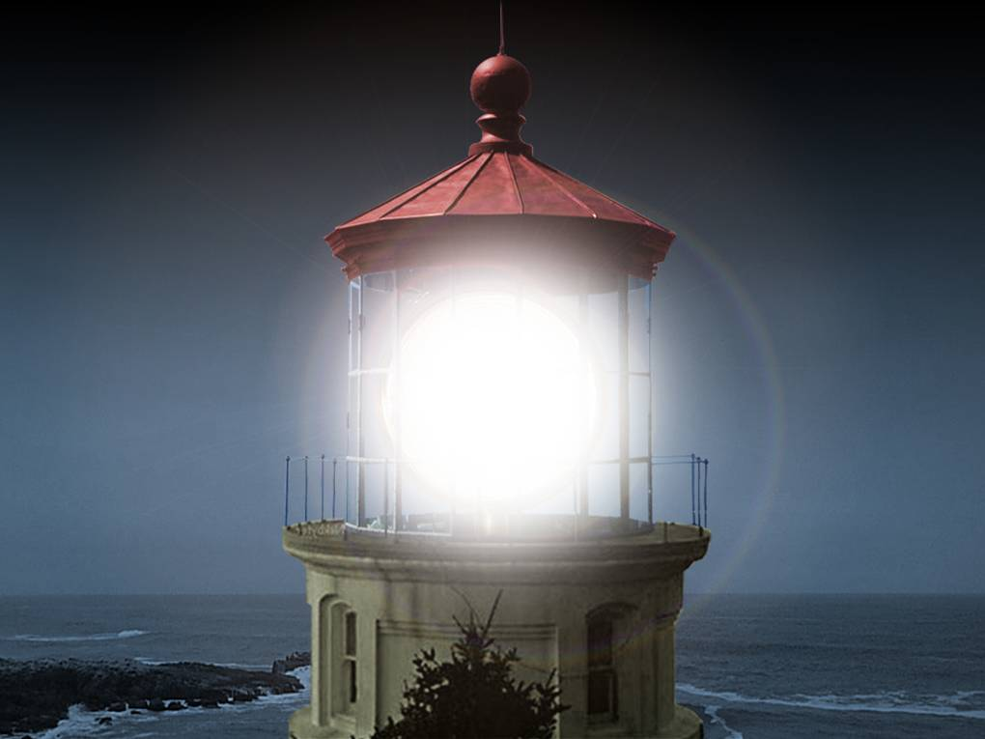
Why Should NASA Care About Zodi? The Local or ExoZodi Challenge To Planet Detection
Stars are a billion times brighter …
Notes:
SCRIPT: Stars are a billion times brighter…
-----------------------
WHAT’S ON THE SLIDE: Artist’s rendering of a lighthouse with beacon shining.

Slide 19
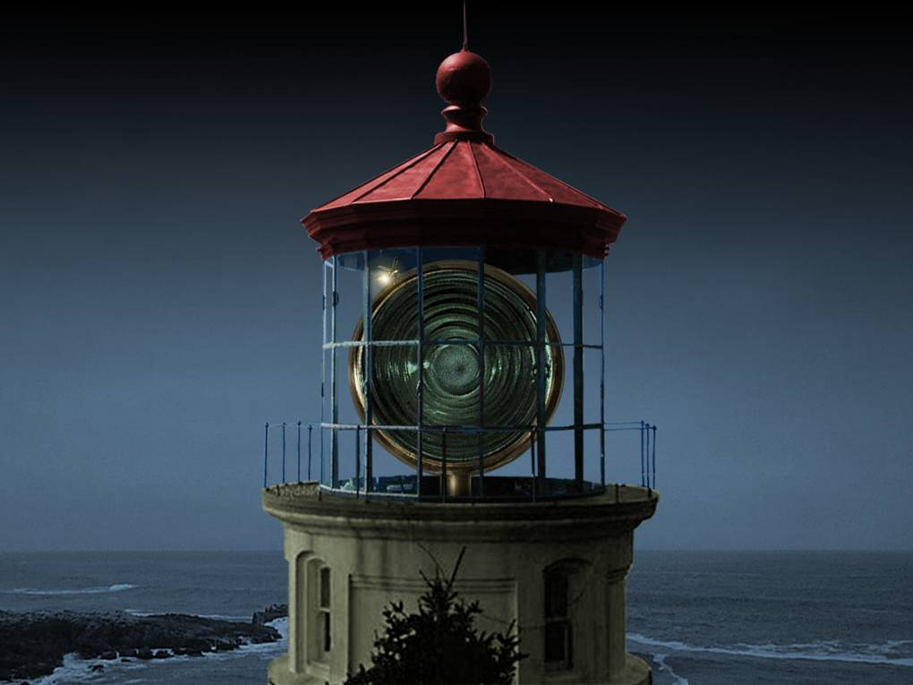
…than the planet
…hidden
in the glare.
Notes:
SCRIPT: …than the planet
[Click space bar]
…hidden in the glare.
-----------------------
WHAT’S ON THE SLIDE: Artist’s rendering of a lighthouse with beacon off. A small firefly is perched atop the lighthouse lamp.

Slide 20
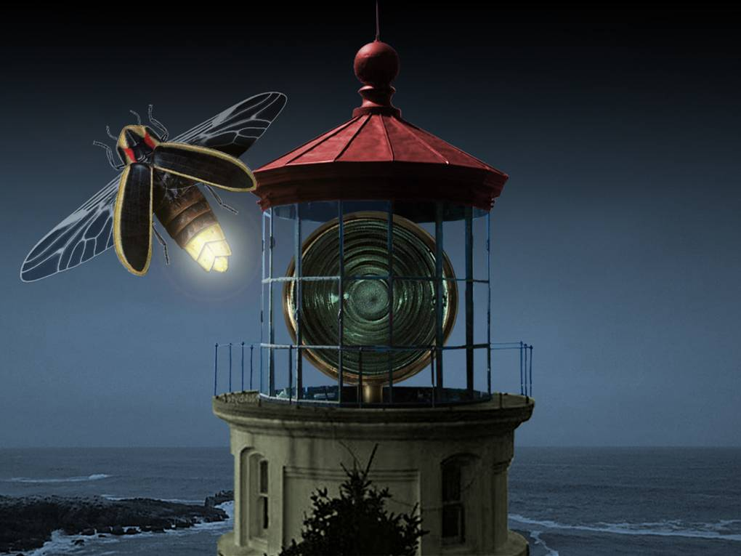
Like this firefly.
Hidden in the
Exo Zodi Fog
Notes:
SCRIPT: Like this firefly.
-----------------------
WHAT’S ON THE SLIDE: Artist’s rendering of a lighthouse with beacon off. The firefly comes into full view.
-----------------------
EXTRAS: Some NASA missions on the drawing board are being designed specifically to block out the bright light from the parent star. The coronagraph design for the Terrestrial Planet Finder mission is one example of the break-through technologies that will be needed to find Earth-like planets near bright stars.

Slide 21
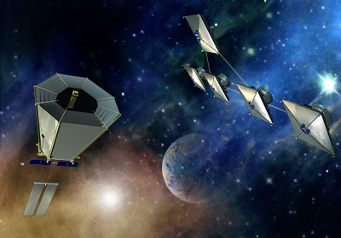
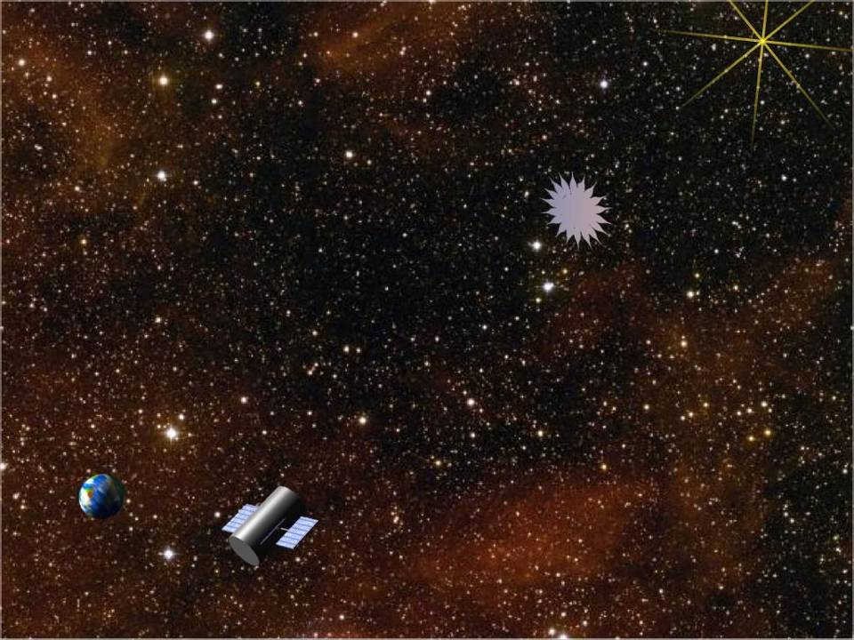
Influence of Zodiacal
Emission on Planet Finding
TPF-Coronagraph (TPF-C)
TPF-Interferometer
(TPF-I)/ESA Darwin
External Occulter (TPF-O)
Notes:
SCRIPT: As NASA gets ready to launch the most sensitive instruments ever built.
[Click space bar]
And with these missions, we will use different methods to find planets.
-----------------------
WHAT’S ON THE SLIDE: Artist’s rendering of the separated instruments of the Terrestrial Planet Finder. This design is just one of two competing designs for this future planet-finding mission.
-----------------------
EXTRAS: The exciting news is that new technologies are again on the horizon–new technologies being developed by NASA and others (such as the European Space Agency) that are allowing us to find and map other solar systems and may soon allow us to actually discover other Earths. Throughout the history of science, new technologies open the door to new discoveries. More sensitive detection tools allow us to investigate objects or phenomena which were beyond our reach.

Slide 22
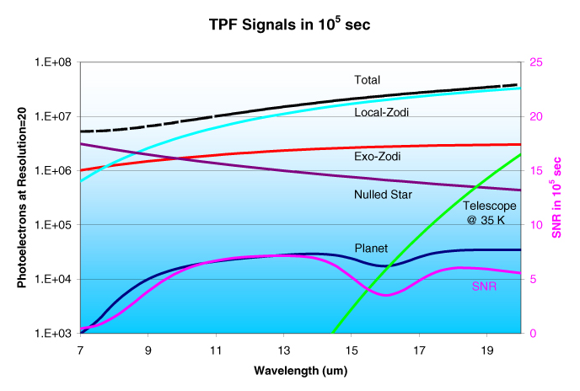
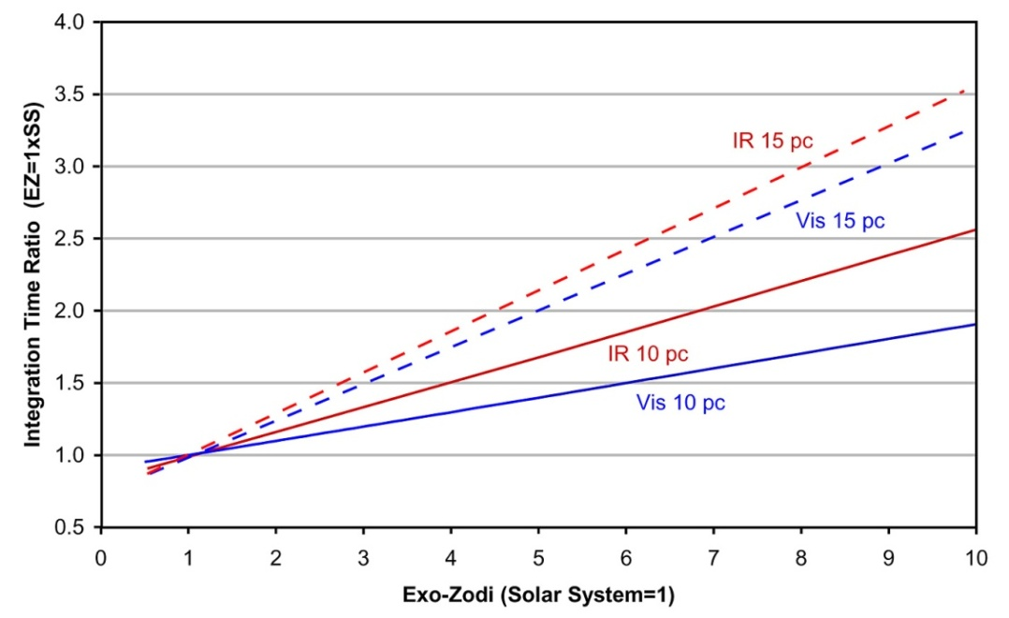
Zodi Problem for Earth-Detection
Local zodiacal important noise source---put observatory at 5 AU (Leger et al)
Photon noise from EZ can overwhelm planet
Total EZ ~300 x planet Solar System Zodiacal cloud
EZ signal within single pixel (~λ/D) significant for >10 zodi for either visible or IR

Slide 23
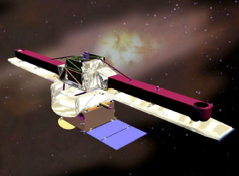
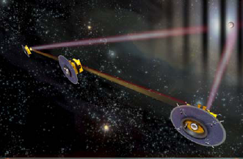
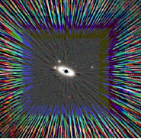
The Next³ Step: A Dedicated Space Mission
5-10 μm interferometry from space can reach 1 zodi
  Pegase separated s/c interferometer
  FKSI interferometer on a stick being (Danchi et al)
Visible coronagraphy (Trauger, Stapelfeldt)
  High contrast imaging with ~2 m telescope at 1-5 zodi as well as imaging nearby Jupiters
Stapelfeldt et al 2007

Slide 24
What Could We Learn About ExoZodi From Local Zodi
Proposed mission in 1996---good idea then, still compelling now
Know more about EZ than LZ, particularly beyond 1-3 AU
  Steepness of drop-off at asteroid belt→ origin of material
  Physical properties of dust from in situ measurements and spectroscopy
Site Survey for future observatories

Slide 25
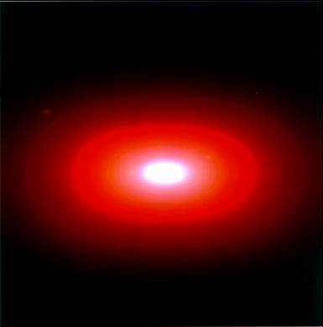
A Proposal for a Discovery Class Mission:
The Local Zodiacal Mapper (LZM)
Submitted 11 December, 1996
Table 4. Science Team Roles
Role | Team Member
Solar System | Backman
structures, | Beichman
Zodiacal cloud modeling, | Dermott Leger
Relation to exo-zodi | Reach
clouds | Sykes
CIRB Theory | Mather
and Analysis | Phinney
 | Wright
Cirrus | Boulanger
 | Cutri
 | Helou
Science Operations | Cutri
 | Van Buren
Instrument | Beichman
 | Gautier
 | Herter
 | Mather
 | Moseley
Data | Beichman
Processing | Helou
 | Van Buren
 | Wright
Outreach and | Backman
Education | Sykes

Slide 26
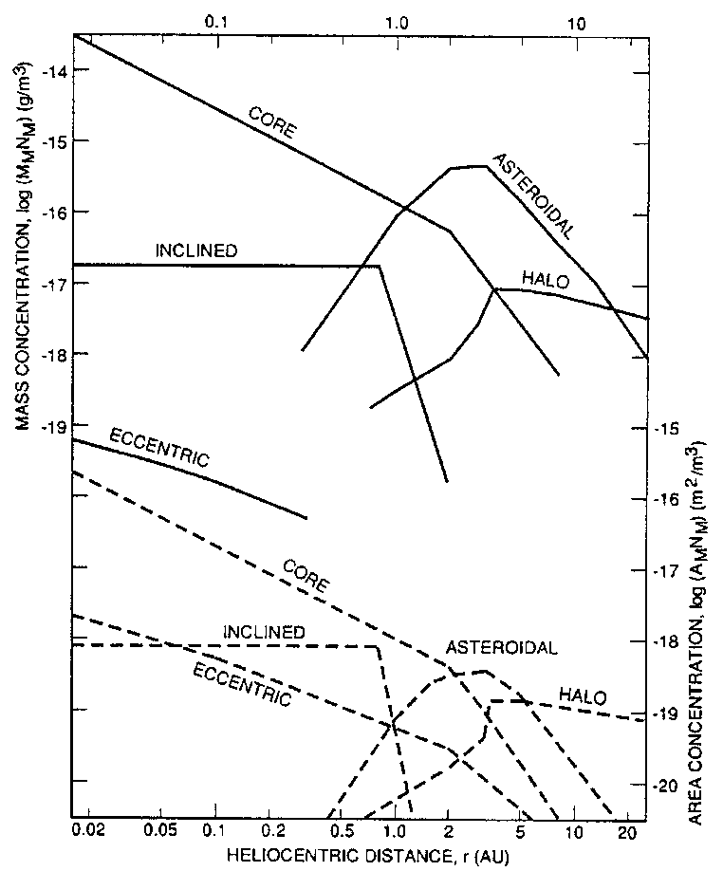
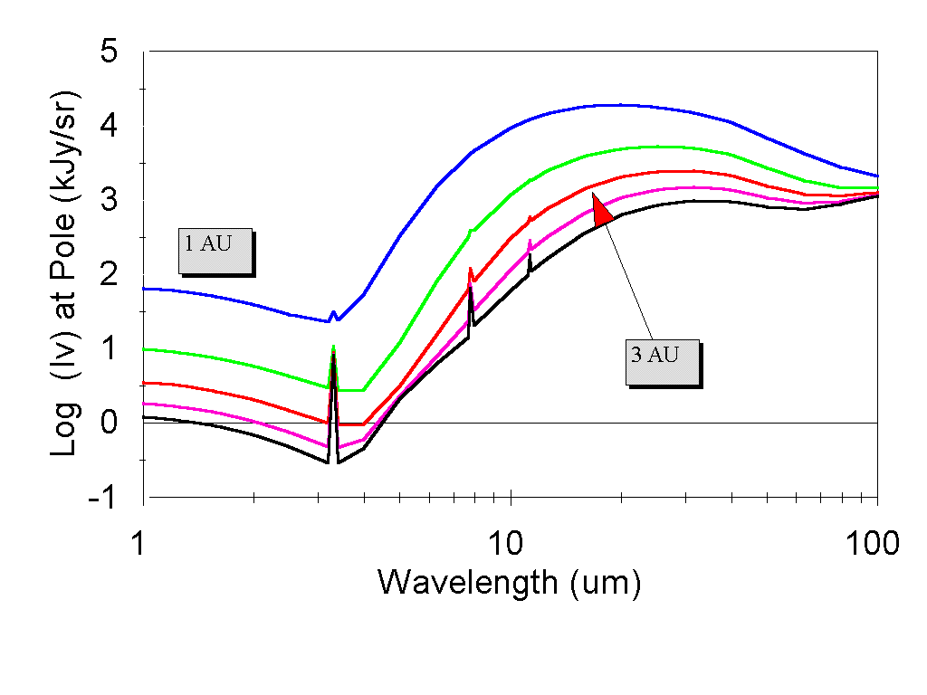
In Situ Studies of the Local Zodi
The mass and surface area estimated for different constituents of the solar system as a function of heliocentric distance. LZM would make direct measurements of the scattered and re-radiated emission from these objects and constrain their properties (Divine 1993).
A model based on IRAS and COBE data obtained at 1 AU (Reach et al. 1996) is used to predict the sky brightness at other distances from the Sun. Curves go from 1 to 5 AU from top to bottom and include zodiacal and cirrus emission. Cirrus features are seen at 3.3, 7.7 and 11 μm.

Slide 27
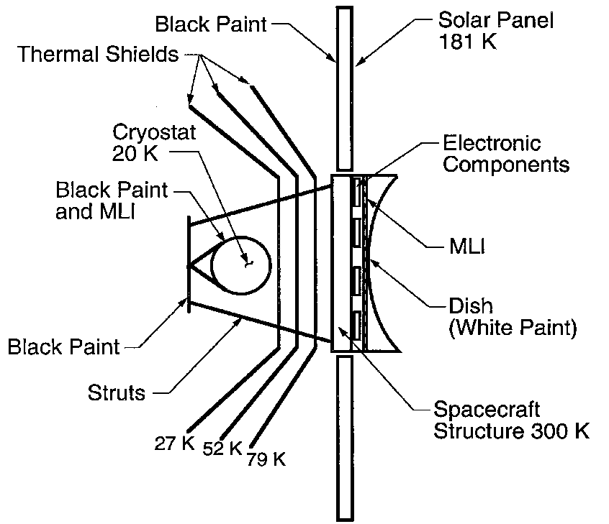
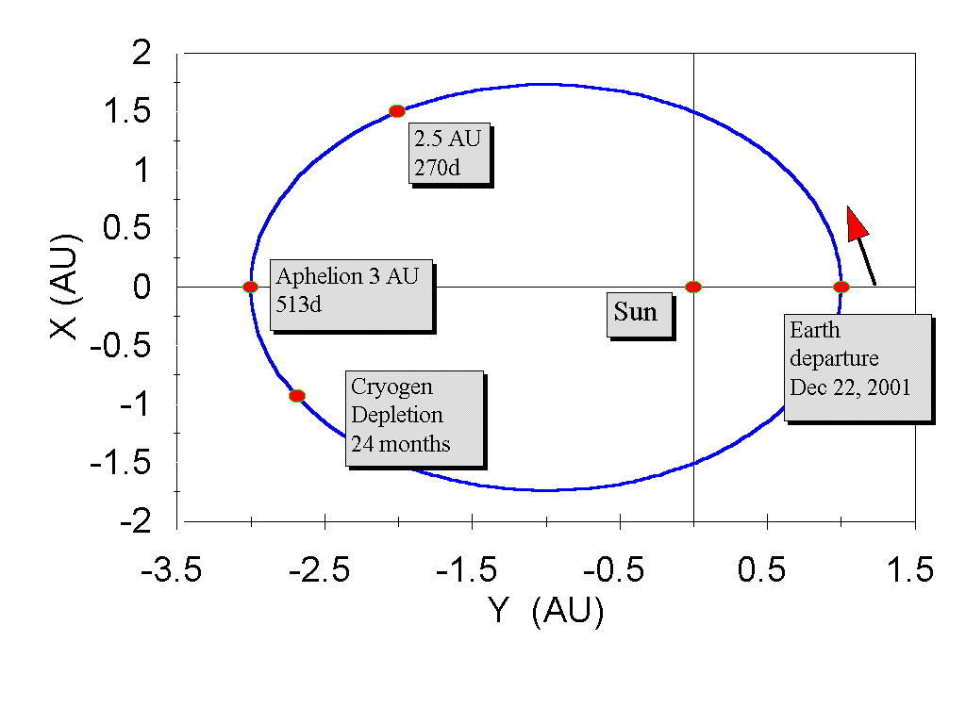
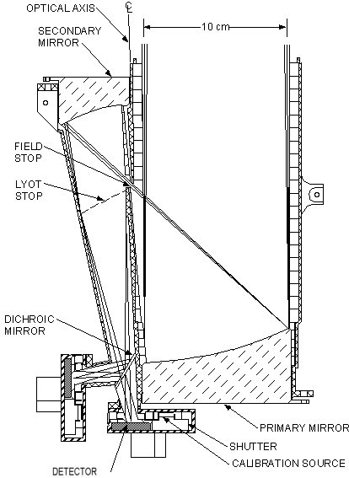
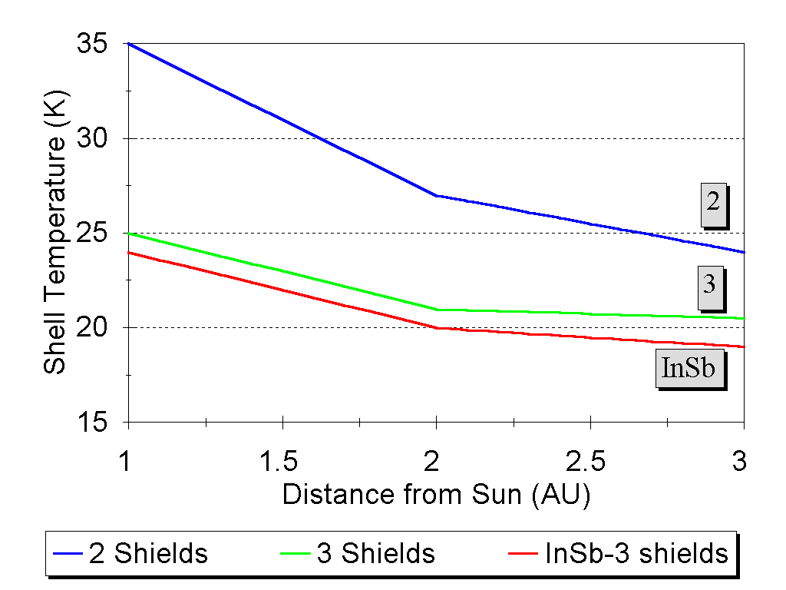
LZM Characteristics
200 kg

